Slide 1
Analyzing systems process: Activity diagram

Slide 2
Outline
Activity diagram concept
Elements of activity diagram
Reading activity diagrams
Process logic in activity diagram
Creating activity diagrams

Slide 3
Activity Diagram (AD) concept
AD used for requirements determination
AD depicts:
process (workflow) – manual & automated
process logic – time order of process steps (activities) & decision points
process performers
AD resembles old flow charts and somewhat data flow diagram

Slide 4
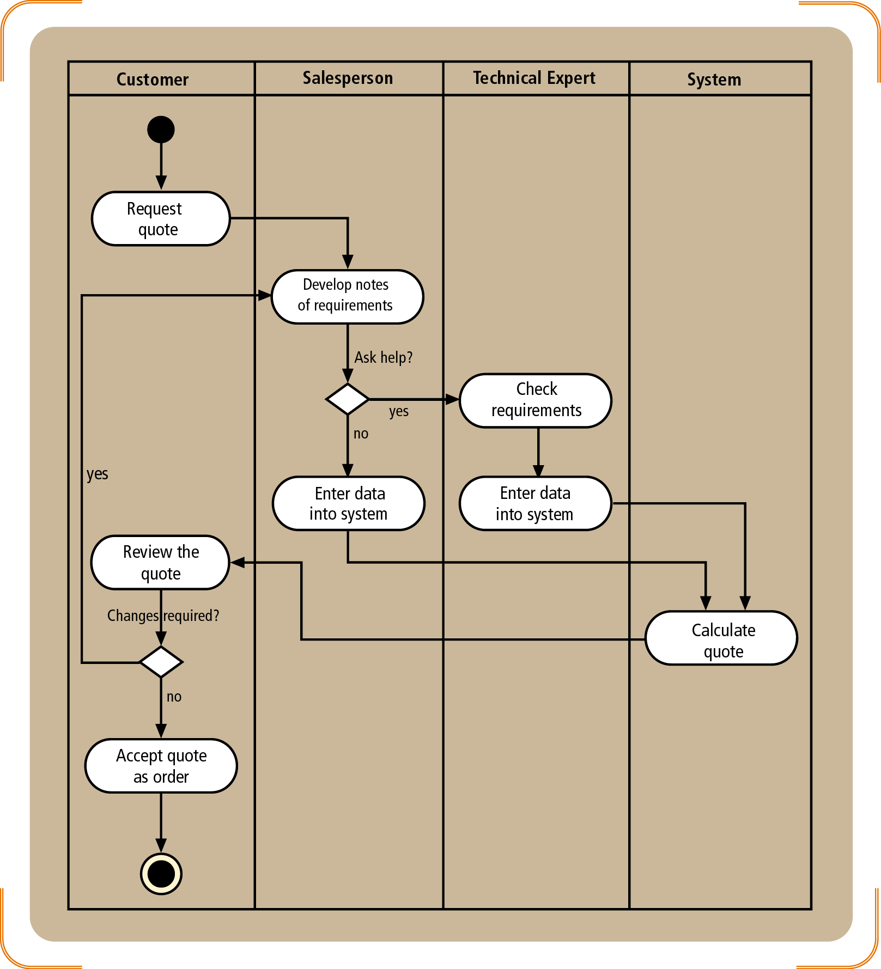
AD elements – Quote process
Page 146
*
Who/What
performs
activity
Start
Swimline
Activity,
Process step
Time
Process
flow
Decision point
(System’s logic);
End
Choices (yes/no);
activity branching
* System=computer, computer software and hardware; same as in use case descriptions

Slide 5
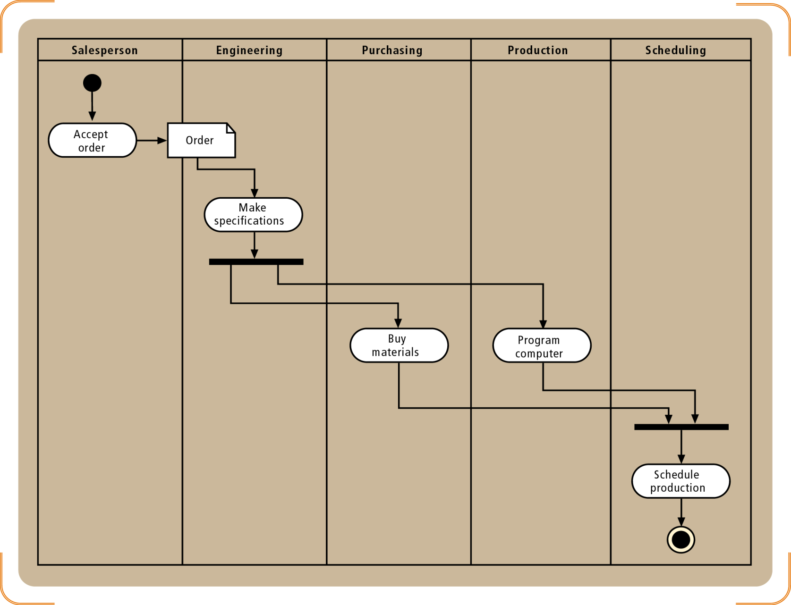
AD elements (cont.)
Page 147
Synchronization
Bar
Parallel
processes
Synchronization
Bar

Slide 6
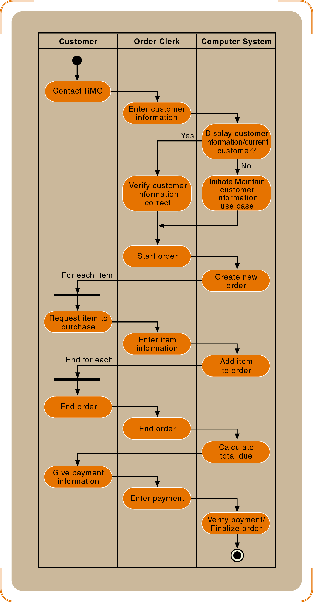
AD diagram of the Telephone Order Process
Page 227
Should present same
information as full
use case description
in Fig. 6-10, p, 223.

Slide 7
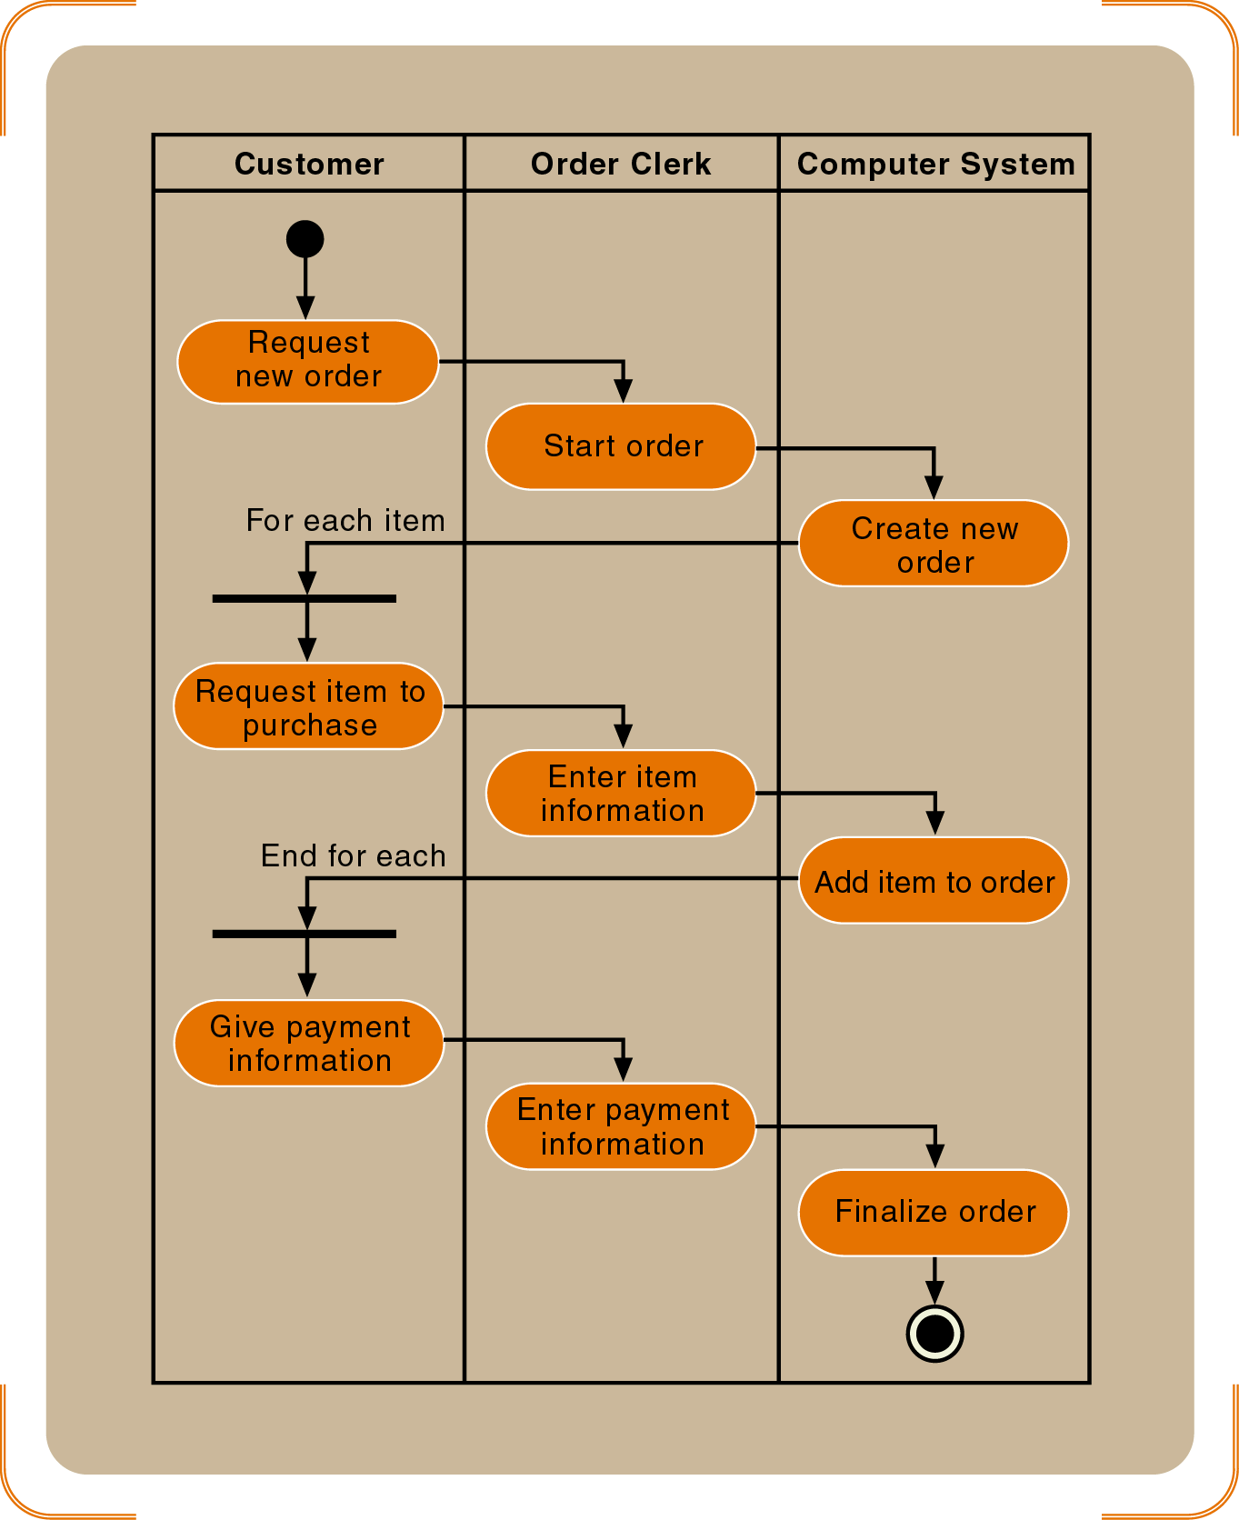
AD of the Telephone Order Process – simpler (cont.)
Page 232

Slide 8
Process logic
Sequential (step 1 → step 2)
Conditional, If-Then (decision points: if condition A, then step n)
Iteration, loops (feedback into a previous step while certain condition persists
Slide 4, feedback from the “Change required?” decision point)
Slide 6, loop between bars For each item to End of each

Slide 9
What AD does not show?
Data passed between steps
Objects (directly, can be inferred)
User interface

Slide 10
How to create AD
Identify activities (steps) of a process
Identify who/what performs activities (process steps)
Draw swimlines
Identify decision points (if-then)
Determine if step is in loop (For each…, if-then based loop)
Determine if step is parallel
Identify order of activities, decision points
Continues…

Slide 11
How to create AD (cont.)
8. Draw the start point of the process in the swimline of the first activity (step)
9. Draw the oval of the first activity (step)
10. Draw an arrow to the location of the second activity
11. Draw subsequent activities, while inserting decision points and synchronization/loop bars where appropriate
12. Draw the end point after the last activity.
You can tabulate this information (see next slide).

Slide 12

How to create AD (cont.)
Step ID | Process Step (Activity, Decision) | Who/What Performs Step | Parallel Activity | Loop | Prece-ding Step
1 | Request quote | Customer | No | No | -
2 | Develop requirement notes | Salesperson | No | Yes | 1
3 | Decision: Help? | Salesperson | - | Yes | 2
4 | Salesperson enters data | Salesperson | No | Yes | 3
5 | Check requirements | Technical Expert | No | Yes | 3
6 | Tech. expert enters data | Technical Expert | No | Yes | 5
7 | Calculate quote | System | No | Yes | 4, 6
8 | Review quote | Customer | No | Yes | 7
9 | Decision: Changes? | Customer | No | Yes | 8
10 | Accept quote as order | Customer | No | No | 9
1
2
5
3
4
6
8
7
9
10

